Slide 1





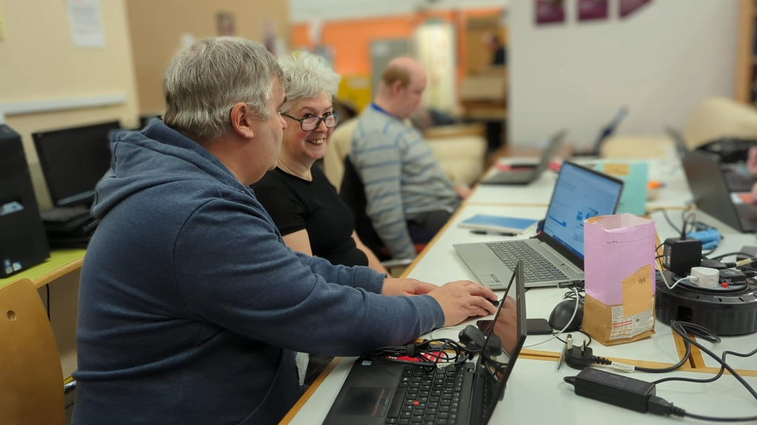
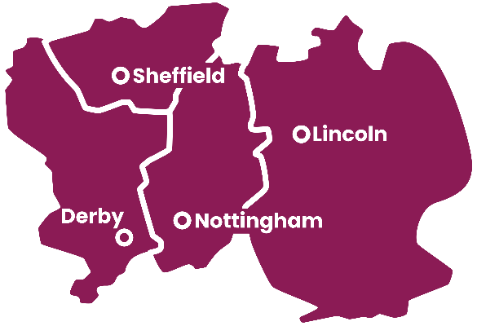


Impact Report for
Thank you for donating your surplus IT Equipment to Framework!
Framework is a charity supporting people experiencing homelessness across Nottinghamshire, Lincolnshire, Derbyshire, and in Sheffield.
.
Our Digital Inclusion Project aims to provide Framework service users with hardware, training and additional support, enabling them to access vital online resources.
.
Staffline have donated the largest number of laptops and equipment to the Digital Inclusion Project. Your donated devices are helping people experiencing homelessness to enrich their lives and aspire to a better future.
SO FAR STAFFLINE HAS ENABLED MORE THAN 630 PEOPLE IN 28 FRAMEWORK SERVICES TO ENGAGE WITH DIGITAL TECHNOLOGY AND ACCESS VITAL ONLINE SUPPORT
Previously, people living in our accommodation services had no dedicated laptops or desktops to access the internet.
Now every Framework service has a laptop, enabling residents to access vital services for healthcare, housing, work or connect with friends and family online.
Your donation of 50 Chromebooks enabled us to start a new project, providing laptops to service users within education.
This has improved the learning opportunities of all 50 recipients.
Staffline’s support has been transformational. Your donated hardware forms the backbone of our Digital Inclusion project.
Staffline’s donated hardware makes up more than 35% of all Framework Laptops, enabling our services users to enrich their lives by studying a range of online courses including cyber security and video editing.

Slide 2

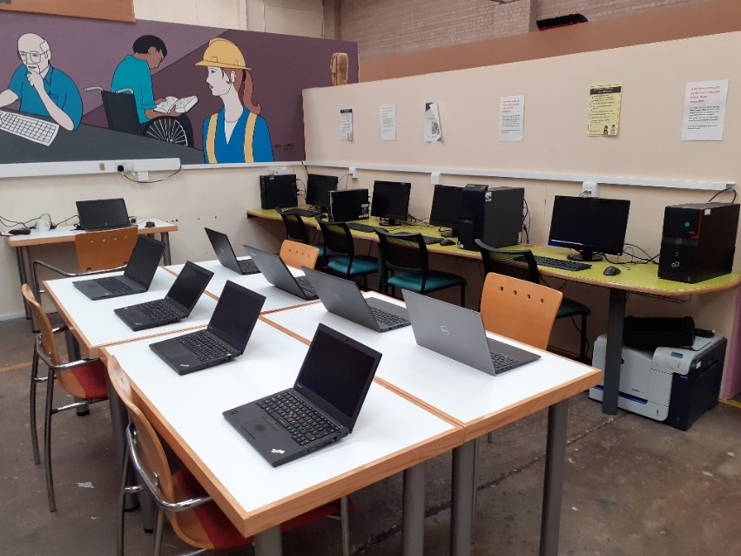





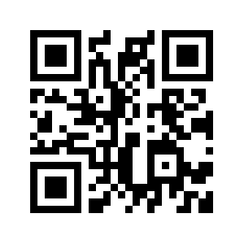

YOUR SOCIAL AND ENVIRONMENTAL IMPACT
The UK generates around 6 million tonnes of e-waste every year and only recycles 31.2% of it.
By donating your unwanted electronic assets to Framework for reuse and recycling, you are reducing your e-waste profile, increasing the life-span of your assets and providing potentially life-changing opportunities for people experiencing homelessness.
YOUR DONATIONS CONSTITUTE A SAVING OF £18,663
We refurbished the machines you donated in 2022, extending their operating lifespan to 2028.
THAT’S 664 YEARS OF ADDITIONAL LIFE!
Your support enables us to divert vital funds to wherever the need is greatest
CAN YOU SUPPORT US FURTHER?
Donate your old laptops and Desktops
Your old laptops could be used in our hostels, enabling more residents to access the internet.
Your laptops could be loaned to people in the community, who are facing social isolation or may wish to access online courses
Your desktops could be used in our Digital Inclusion and Learning Hubs in Nottingham, Lincoln and Newark, enabling more people to access our regular IT support sessions.
We use a cloud-based OS that works well with machines up to 18 years old. Don’t write off your dusty old machines. If it has a power lead and turns on, we can probably use it to improve someone's life.
Phones
Many people come to Framework without a phone, which leaves them unable to contact Framework and other important services. Donate your old unlocked phones and connect someone to the help they need.
Additional IT
Please donate any additional IT equipment to make a difference to someone’s life.
If we can’t use it, we will sell it to enable the purchase of alternative digital resources.
Get in Touch:
digital-inclusion-team@frameworkha.org
Visit our website: access4all.uk

